Slide 1
Palette Picker
Eric Brewer, Simon Stockton, Lily Thompson, Victoria Senn

Slide 2


01
02
03
04
Purpose
Overview of function and use cases.
Technology & Design
Technology used and how the application works.
Bugs & Issues
Current bugs and issues with the application, as well as issues in development.
Future Work
Things that aren’t completed that were promised initially.

Slide 3
What can the Palette Picker do?
Creates palettes from
Images
Manual color selection
Social features
Create account
Login
Save palette

Slide 4
Use cases:
Painting
Graphic Design
Pottery

Slide 5
Learning the Technology
The technology used in this project was pretty much foreign to all of us
Learning the new technology took a large chunk of time during the development of this project
We believe that we became much more educated about web development in the duration of the project

Slide 6
Applying the Technology
HTML and CSS were used to create the UI’s
PHP was used to run the backend
MySQL was used to run the database
JavaScript was used to develop the palette creators
Apache is running off Ubuntu on a Linode server

Slide 7
Technology Changes
We originally believed NodeJS and Express would be the best way to handle the backend due to our miniscule amount of experience in JavaScript
PHP proved to be much easier to get us over the learning curb

Slide 8
Design: all the files pt.1
index.html - This is the homepage of our project where the user will have access to the main functions of the project
login.php and createaccount.php work together so that the user can send a new account to the database and log in to that account
Colorpicker.js and FromImage.html work together to create palettes from an image

Slide 9
Design: all the files pt.2
manual_code.js and Pallet_screen.html work together to give users the ability to create palettes from scratch
Search.php and LargePalettePage.php gives users the ability to search previously created palettes from the database and view relevant data about the created palettes

Slide 10
The Algorithm
The Algorithm used to pull from a palette changed many times over the course of the project
Current algorithm splits image into four quadrants and takes average of each quadrant
Fastest and most accurate so far, but still has room for improvement

Slide 11
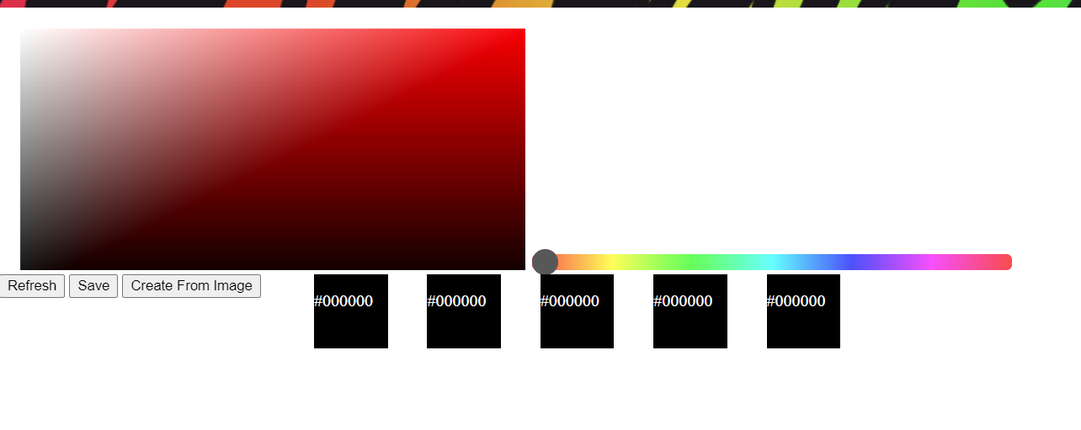
Design: Palette Picker (Manual)

Slide 12
Design: Palette Picker (Manual)
Gradient based off hue selected from slider
Selected box can be changed to any color from the gradient
Refresh button sets all boxes to black

Slide 13
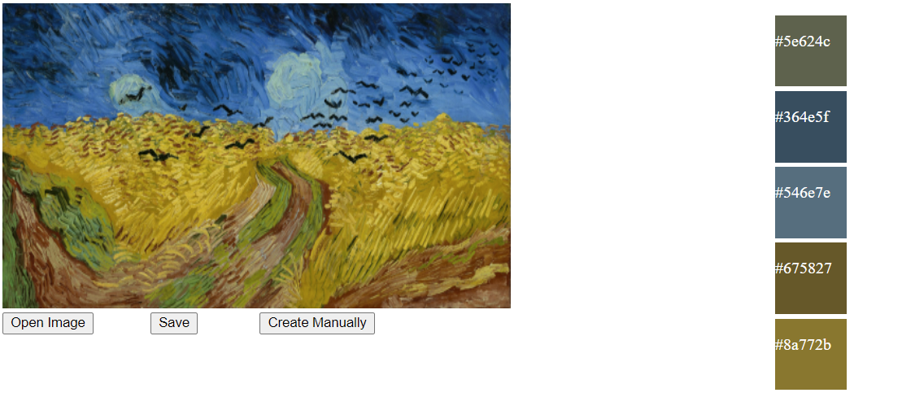
Design: Palette Picker (From Image)

Slide 14
Design: Palette Picker (From Image)
‘Open image’ button opens windows file explorer for the user to select a .jpg or .png file off their computer
Can’t demonstrate without SSL certificate
Algorithm slices picture into four quadrants and takes average color of each quadrant

Slide 15
Design: Palette Picker
‘Save’ button opens a prompt that allows the user to input a name and save the pallet to their account
‘Create from image’/ ‘Create manually’ buttons to swap between pages.

Slide 16
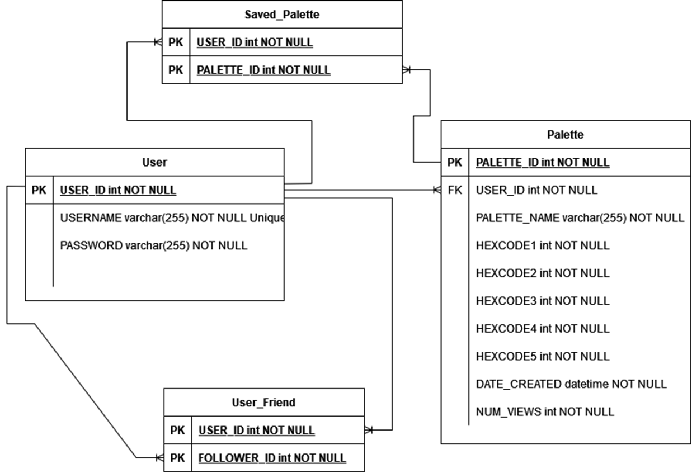
Design: the database
User table, Palette table, User_Friend table, and Saved_Palette table
Relations:
One user->multiple saved palettes
One palette->multiple saved palettes
One user-> can have multiple friends
One user->can be a friend of multiple other users

Slide 17
Design: dbConnection.php
connectToDB and closeDB
getFromDB and sendToDB
Verification functions: verifyUser and verifyUsernameNotTaken
Data selection functions: getUserID, getUserFriends, getUserSavedPaletteID, and getPaletteInfo
Search feature: findPaletteByColor, findPaletteByCreatorUsername, and findPaletteByTitle
Inserting data functions: sendNewUserToDb, sendNewPaletteToDb, getUserHashedPasswordFromDM, and savePaletteForUser

Slide 18
Bugs
Edge of color selector in the manual palette creation causes an error where the color and text goes white
Banner on color selector offsets pointer values for selecting colors
Returning to Home from search and palette does not return to the logged in Homepage

Slide 19
Major Issues
Linode
Since Linode has no free SSL we cannot upload images from a local machine.
Saving
There is an issue saving from both of the palette creation pages into the database.
Integration
Issues from working separately and not integrating and test frequently, as well as technical issues.

Slide 20
Future Work
Fixing the already mentioned bugs and issues
Implementing the social features
Add/remove friend
View friend activity
Alerts page and functionality
Better improve from image algorithm

Slide 21
Final Thoughts
Learning Experience:
New tools
Working in a team
Importance of planning

Slide 22
App Link
http://173.255.205.73/~ericbrew2

